Slide 1
In-class Exercise
ERD

Slide 2
Exercise 01:
An apartment is located in a house in a street in a city in a country.

Slide 3
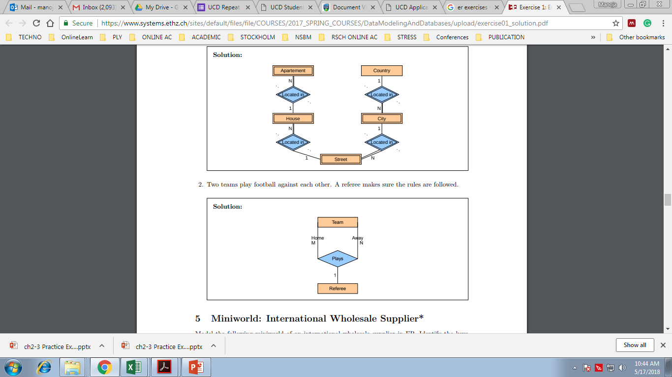

Slide 4
Exercise 02:
Design a database to keep track of what courses a student takes, and information on what professors teach the courses. Given that a student could take many course, a course is also delivered by many professors.
You may decide on the attributes.

Slide 5
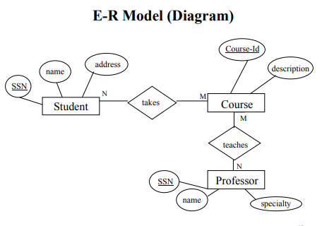

Slide 6
In class-Exercise
See the following requirements list:
The university offers one or more-degree programs.
A degree program has one or more courses that is specific to its discipline.
A student must enroll in a degree program.
A student takes the courses that are part of her program.
A program has a name, a program identifier, the total credit points required to graduate, and the year it commenced.
A course has a name, a course identifier, a credit point value, and the year it commenced.
Students have one or more given names, a surname, a student identifier, a date of birth, and the year they first enrolled. We can treat all given names as a single object—for example, “John Paul.”
When a student takes a course, the year and semester he attempted it are recorded. When he finishes the course, a grade (such as A or B) and a mark (such as 60 percent) are recorded.
Each course in a program is sequenced into a year (for example, year 1) and a semester (for example, semester 1).

Slide 7
ER Diagram for a car insurance company whose customers own one or more cars each. Each car has associated with it zero to any number of recorded accidents. Each insurance policy covers one or more cars, and has one or more premium payments associated with it. Each payment is for a particular period of time, and has an associated due date, and the date when the payment was received.

Slide 8
Exercise 3
You set up a database company, ArtBase, that builds a product for art galleries. The core of this product is a database with a schema that captures all the information that galleries need to maintain.
Galleries keep information about artists, their names (which are unique), birthplaces, age,and style of art. For each piece of artwork, the artist, the year it was made, its unique title, its type of art (e.g., painting, lithograph, sculpture, photograph), and its price must be stored. Pieces of artwork are also classified into groups of various kinds, for example, portraits, still lifes, works by Picasso, or works of the 19th century; a given piece may belong to more than one group.
Each group is identified by a name (like those just given) that describes the group. Finally, galleries keep information about customers. For each customer, galleries keep that person’s unique name, address, total amount of dollars spent in the gallery (very important!), and the artists and groups of art that the customer tends to like.
Draw the ER diagram for the database.

Slide 9
Exercise 3
Solution
year
type
name
title
price
Like_Group
Classify
Group
Artwork
Like_Artist
Paints
Customer
Artist
address
style
cust_id
name
amount
birthplace
age
name

Slide 10
ONLINE ER-Exercise: Do This @home ☺
Create an ERD for the following scenario
The company is organized into DEPARTMENTs. Each department has a name, number and an employee who manages the department. We keep track of the start date of the department manager. Each department controls a number of PROJECTs. Each project has a name, number and is located at a single location. We store each EMPLOYEE’s social security number, address, salary, sex, and birthdate. Each employee works for one department but may work on several projects. We keep track of the number of hours per week that an employee currently works on each project. We also keep track of the direct supervisor of each employee. Each employee may have a number of DEPENDENTs. For each dependent, we keep track of their name, sex, birthdate, and relationship to employee.

Slide 11
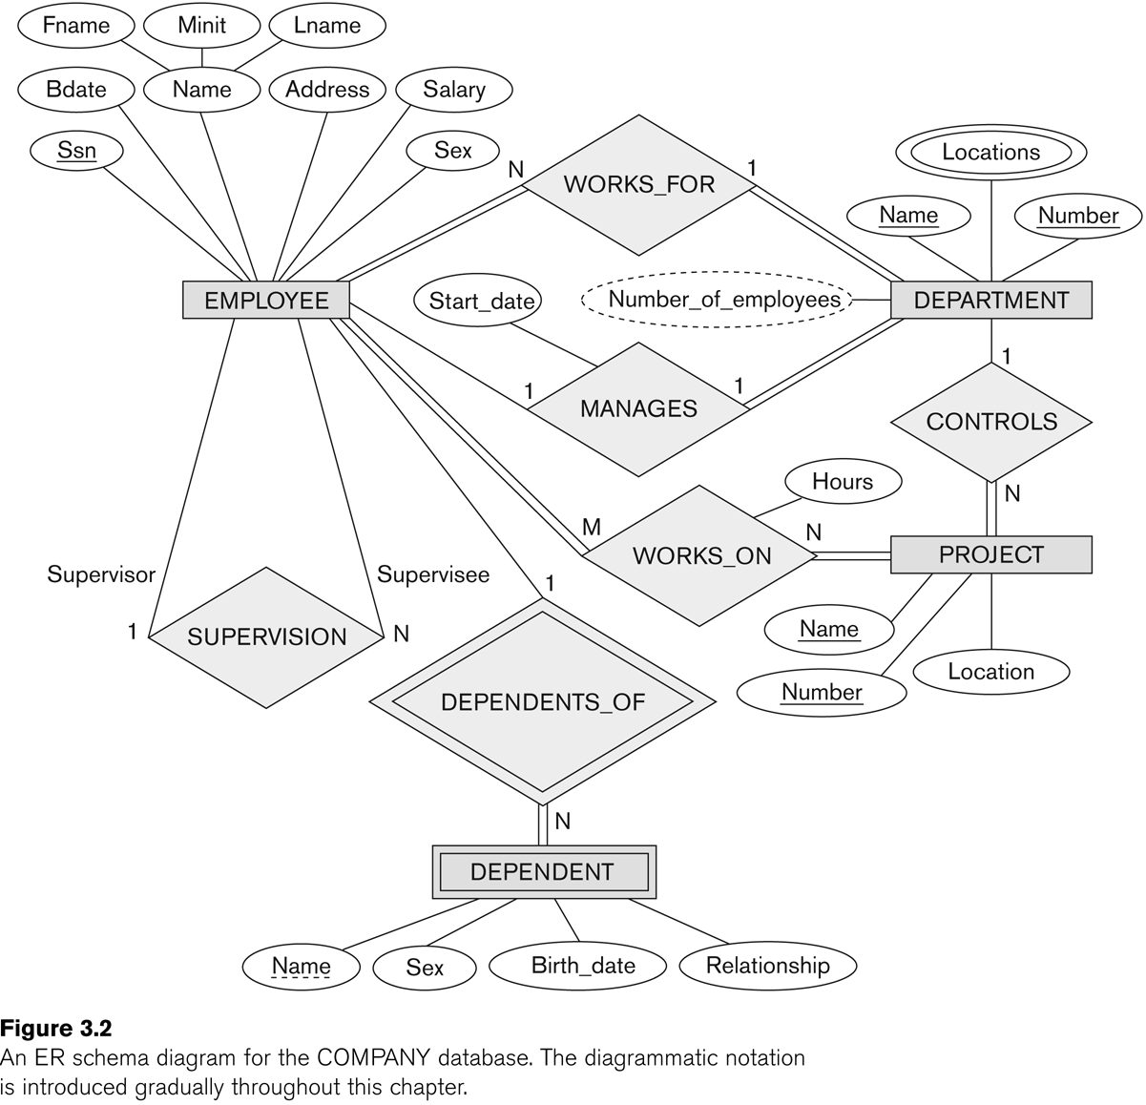

Slide 12
